Slide 1
CodeBook
Gender (F=0, M=1)
Tumor Laterality (L=0, R=1)
Tumor Location (Choroid=0; ciliary=1; ciliochoroidal=2; iridociliary=3; iridociliochoroidal=4; iris=5)
Tumor location quadrant (inferonasal = 1, Superonasal = 2, Nasal = 3, Inferotemporal = 4, Superotemporal = 5, Temporal = 6, Superior = 7 , Inferior macula = 8)
AP epicenter location (1= macula, 2= macula-equator, 3= equator-ora serrata, 4= ora serrata - angle)
AJCC Classification:
1a: 1.1
1b: 1.2
2a: 2.1
2b: 2.2
3a: 3.1
3b: 3.2
4b: 4.2
Biopsy castle classification:
1A: 1.1, 1B: 1.2, None: 0
Prame status: positive 1 negative 0
SRF (Y/N)
Diabetes (Y/N)
HTN (Y/N)
HLD (Y/N)
Glaucoma (Y/N)
ARMD (Y/N)
***For ALL Yes/No questions, Yes = 1, No = 2

Slide 2
Sample size n = 178 (2 dropped bc no BL dates & BCVA)
BCVA followed (after treatment) 30 times MAX, 1 time MIN
All patients had the same type of radiation: I-125
All patients had the same total dose (cGy) to tumor apex: 8500 cGy
Time: Months between treatment and date of BCVA measurement date
Outcome/Event: BCVA worse than 20/200 (LogMar 1.0)
Loss of VA: >=3
Loss of VA: >=5

Slide 3
TDs & ADs of:
Disc Center
Nerve
Retina
Lens
Fovea
Apex
Sclera
Other variables:
Optic Nerve Proximity
Fovea Proximity
Radiation Side Effect
Tumor Location
Tumor Location Quadrant
Tumor size
Baseline 20/40 or better
Tumor laterality
Hemorrhage
Diabetes
Hypertension
Cataract
Edema
Vasculopathy
Papillitis

Slide 4
New Results 12/14
Safe/Optimal

Slide 5
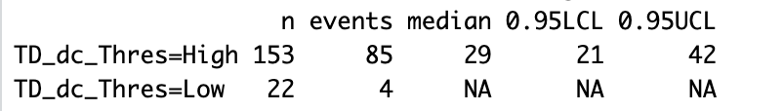
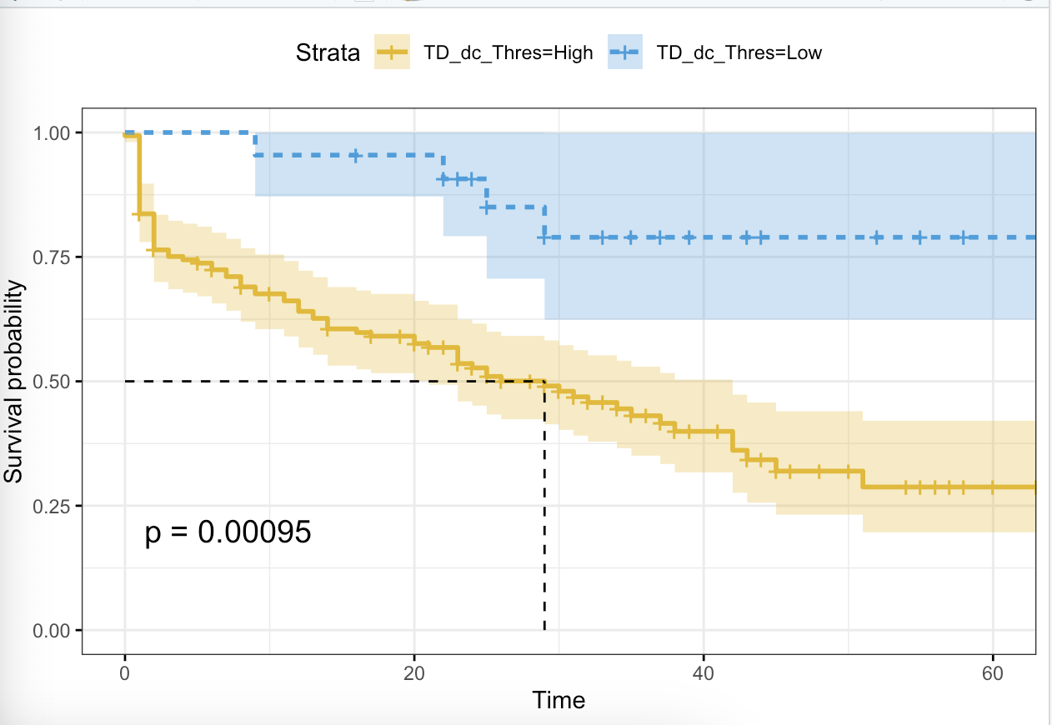
TD_dc
15 (percentile 12.5)

Slide 6
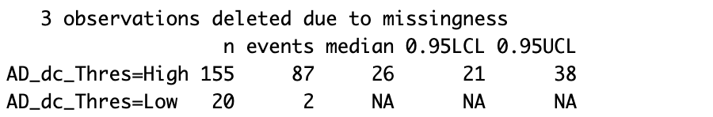
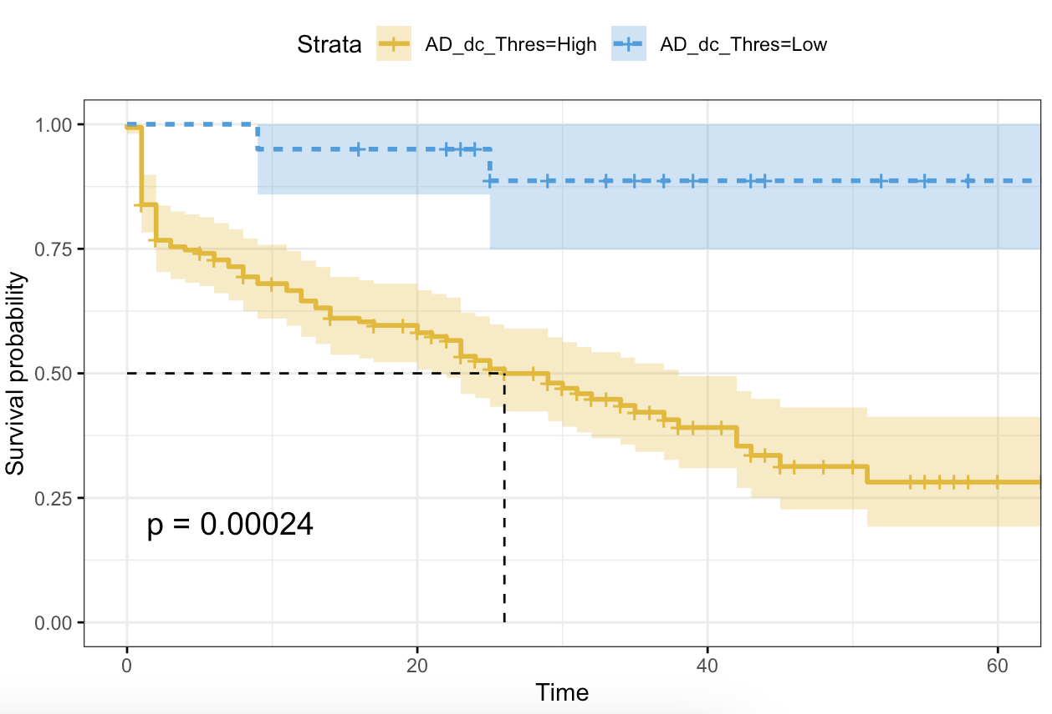
AD_dc
20 (percentile 11.3636)

Slide 7
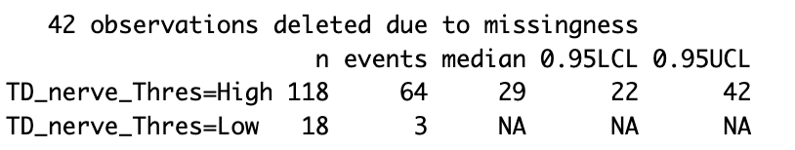
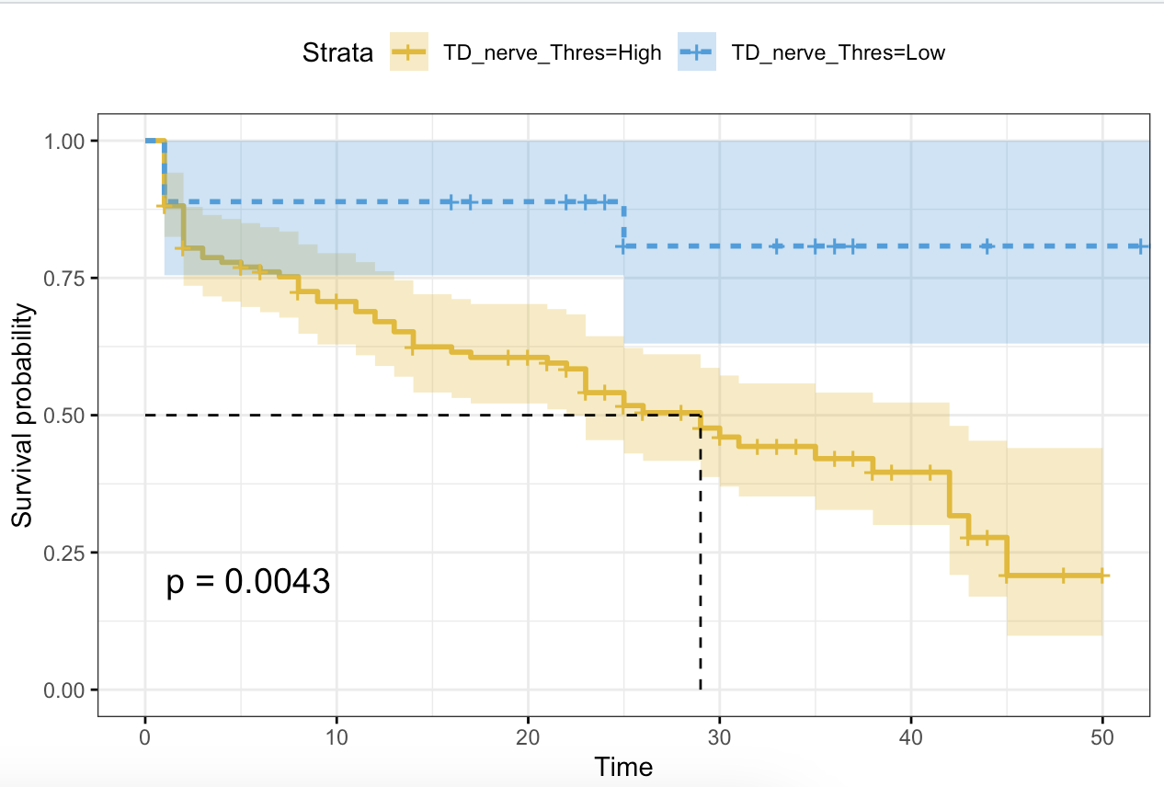
TD_nerve
10 (percentile 13.25)

Slide 8
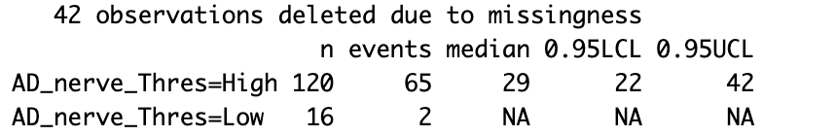
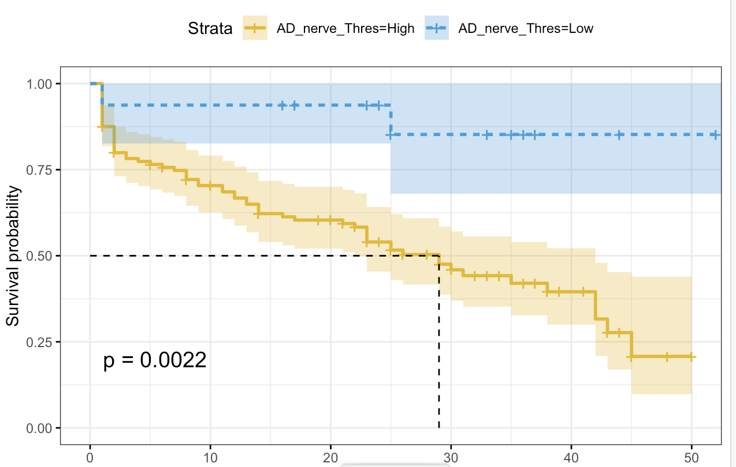
AD_nerve
13 (percentile 11.7647)

Slide 9
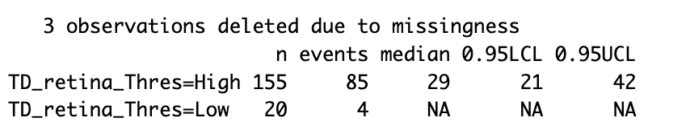
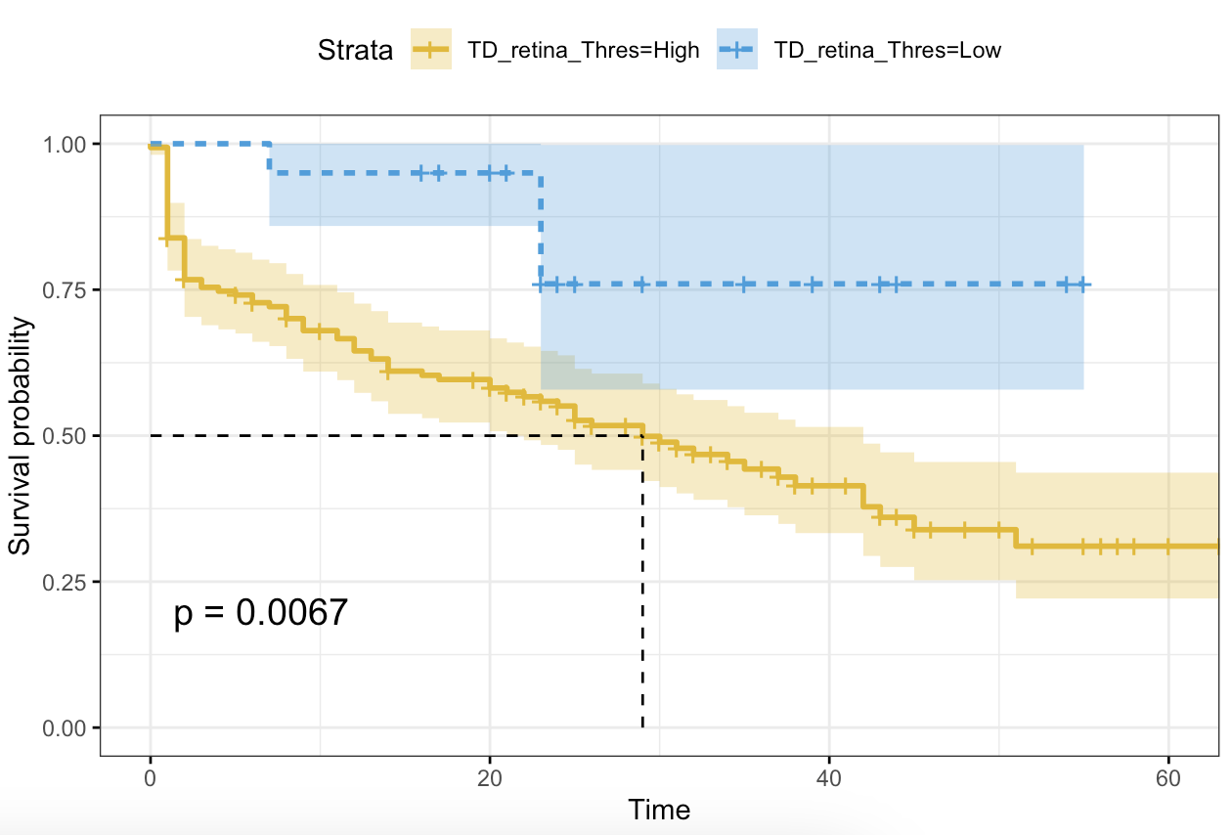
TD_retina
4.0 (percentile 11.3636)

Slide 10
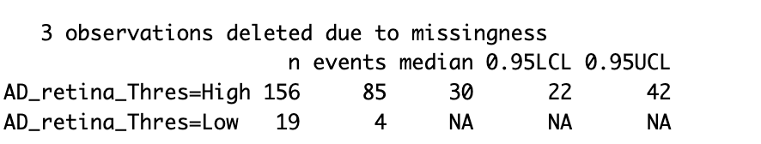
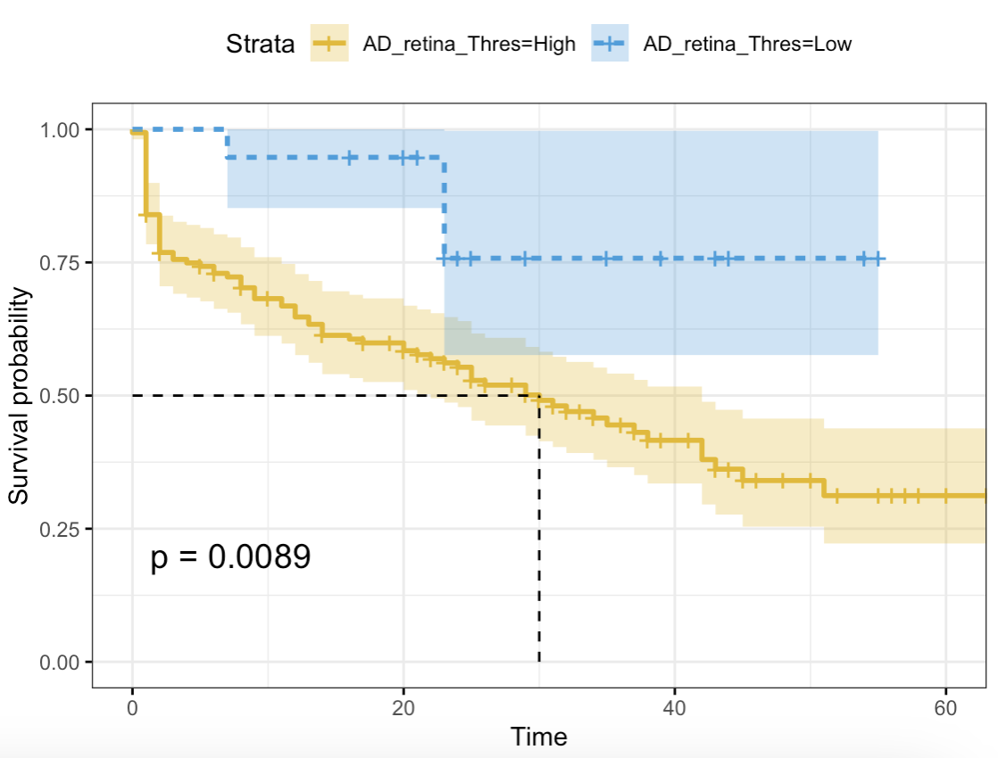
AD_retina
5.4 (percentile 10.7955)

Slide 11
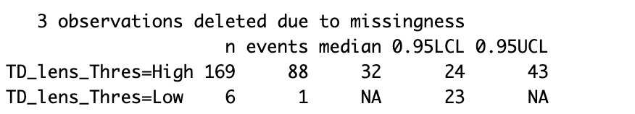
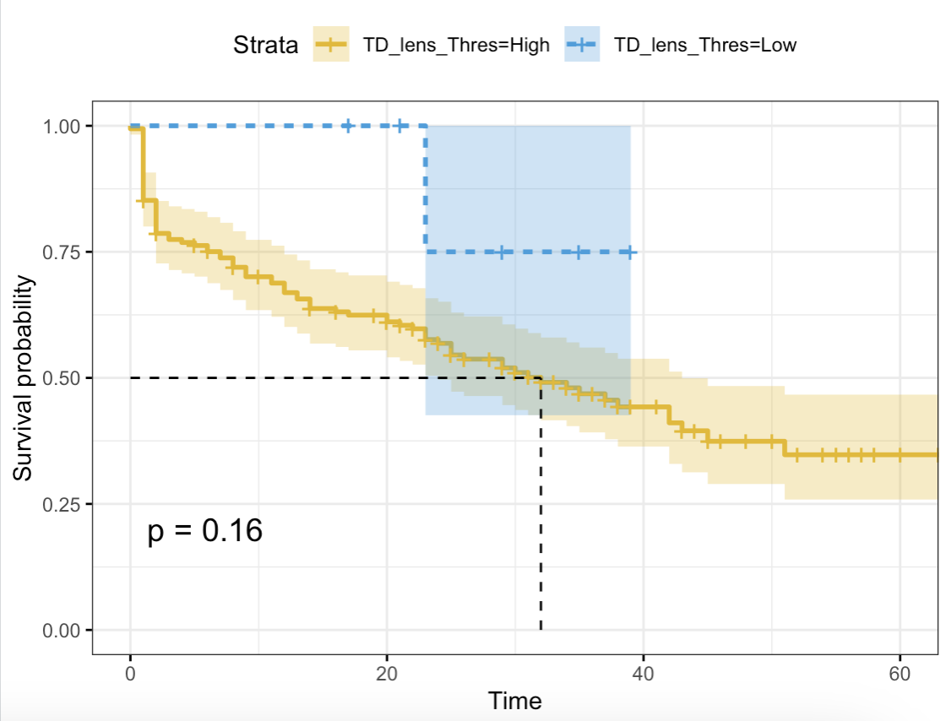
TD_lens
5.8 (percentile 3.4091)

Slide 12
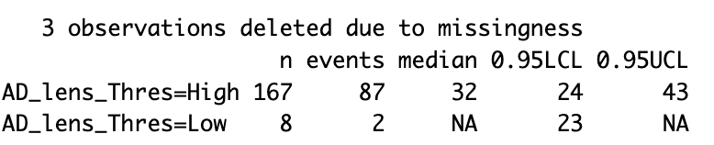
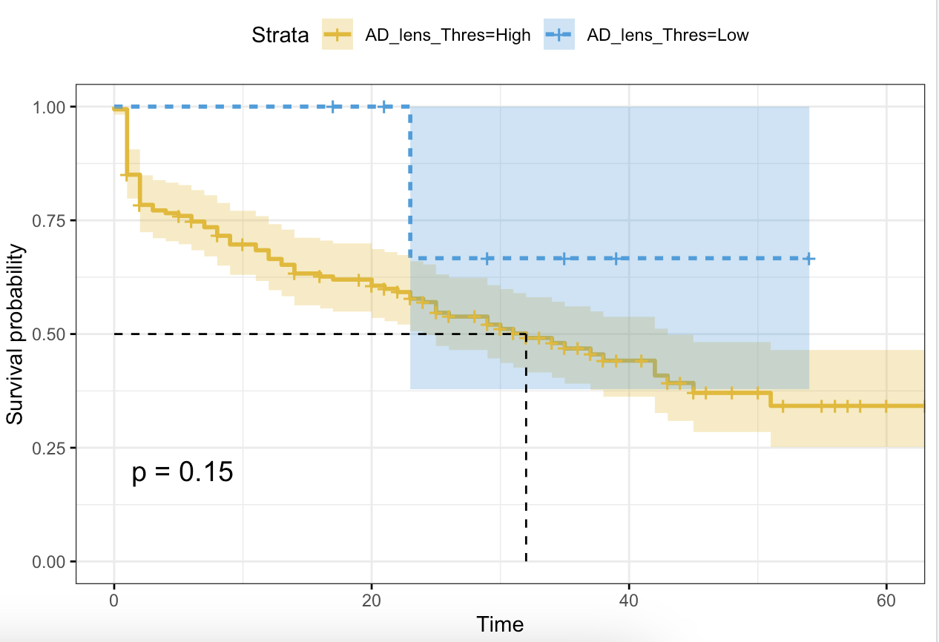
AD_lens
8.4 (percentile 4.5455)

Slide 13
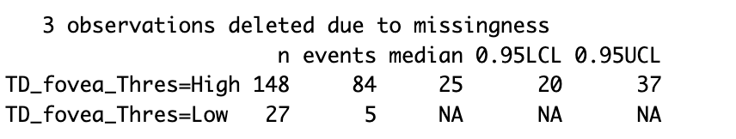
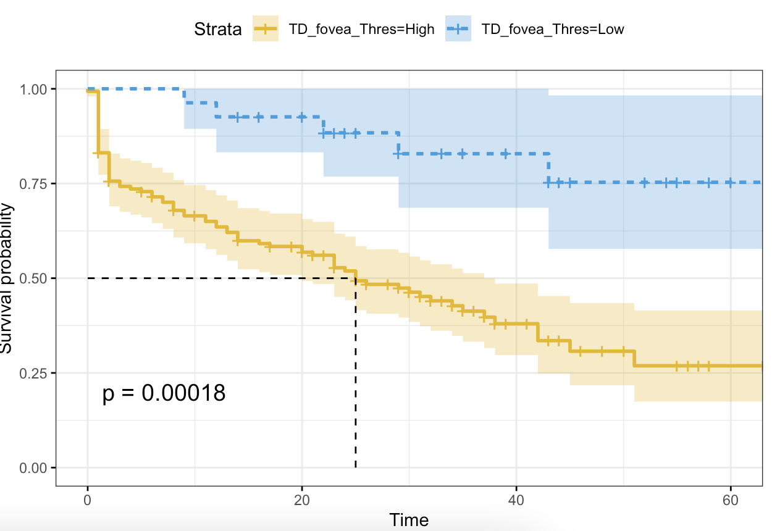
TD_fovea
15 (percentile 15.3409)

Slide 14
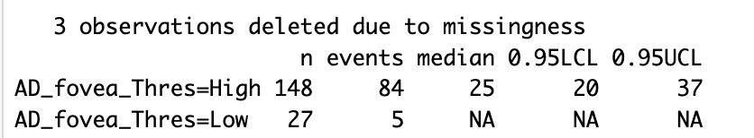

AD_fovea
21 (percentile 15.3409)

Slide 15
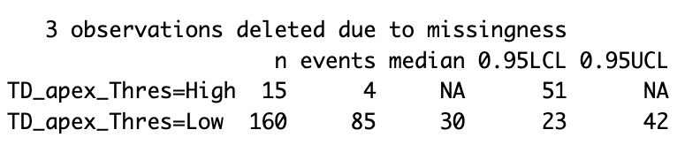
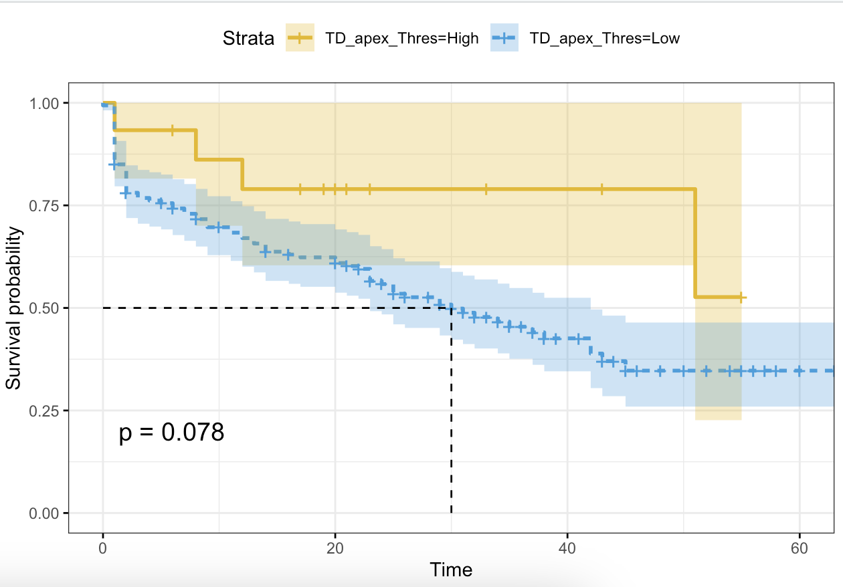
TD_apex tumor
148 (percentile 91.4773)

Slide 16
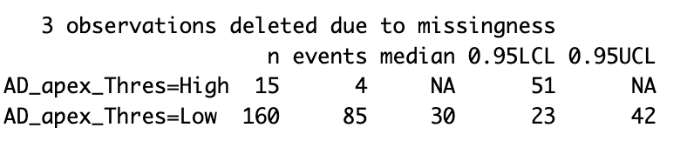
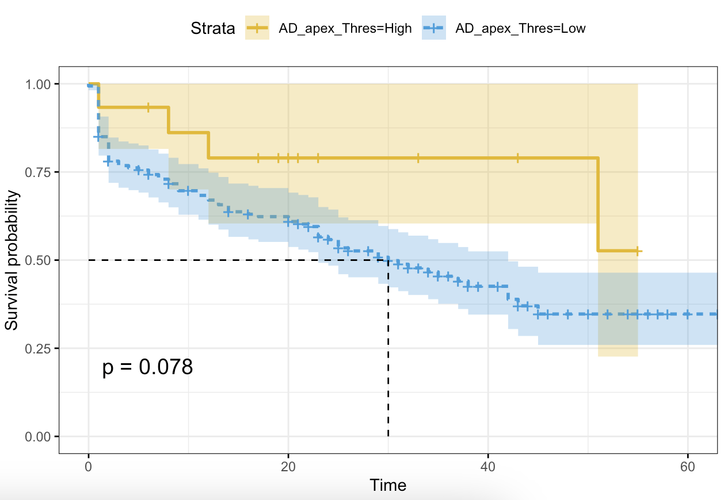
AD_apex tumor
207 (percentile 91.4772)

Slide 17
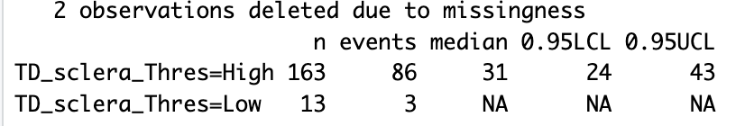
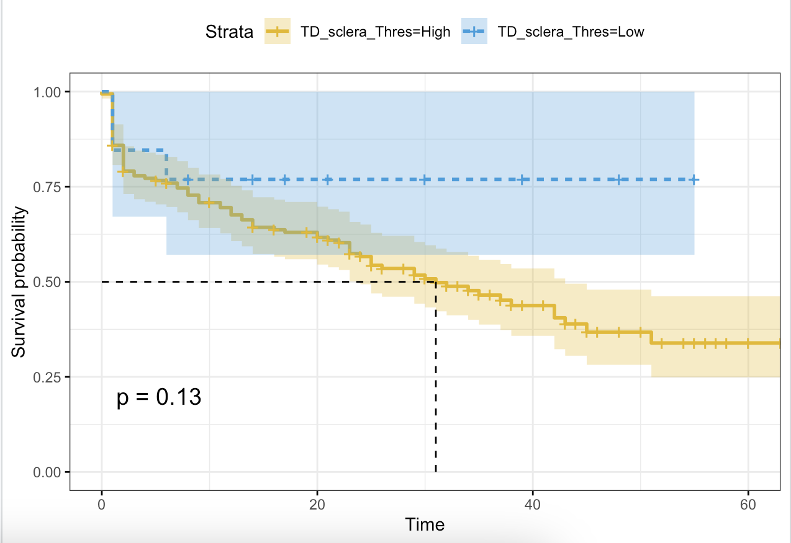
TD_sclera
119.6 (percentile 7.3446)

Slide 18
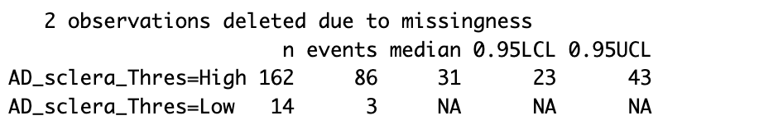

AD_sclera
171 (percentile 7.9096)

Slide 19
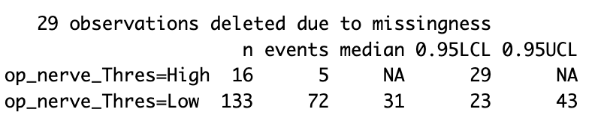
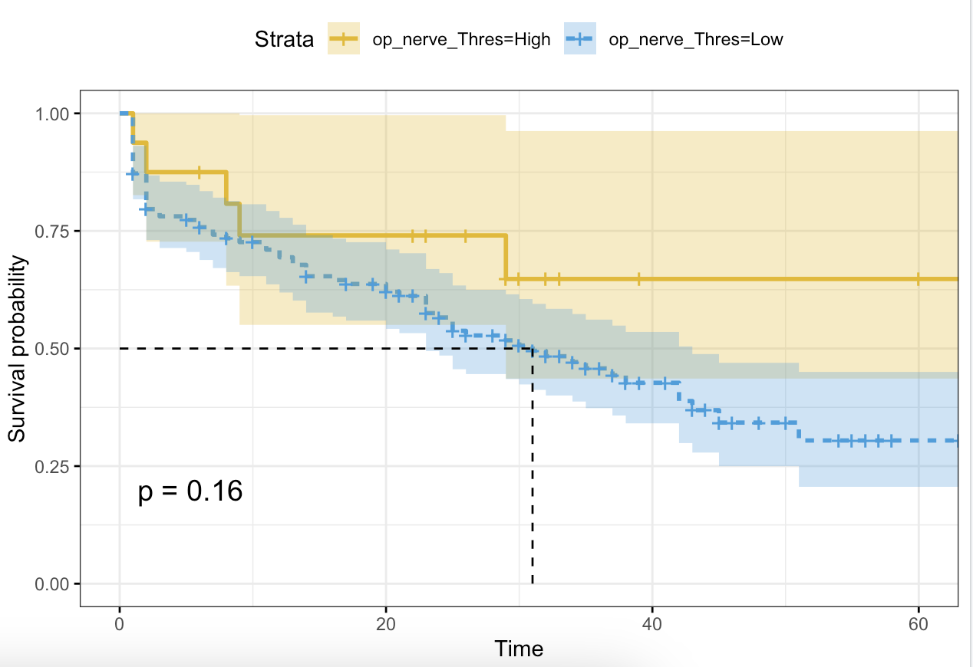
Optic Nerve Proximity
8 (percentile 89.3333)

Slide 20
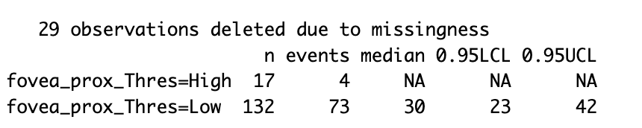
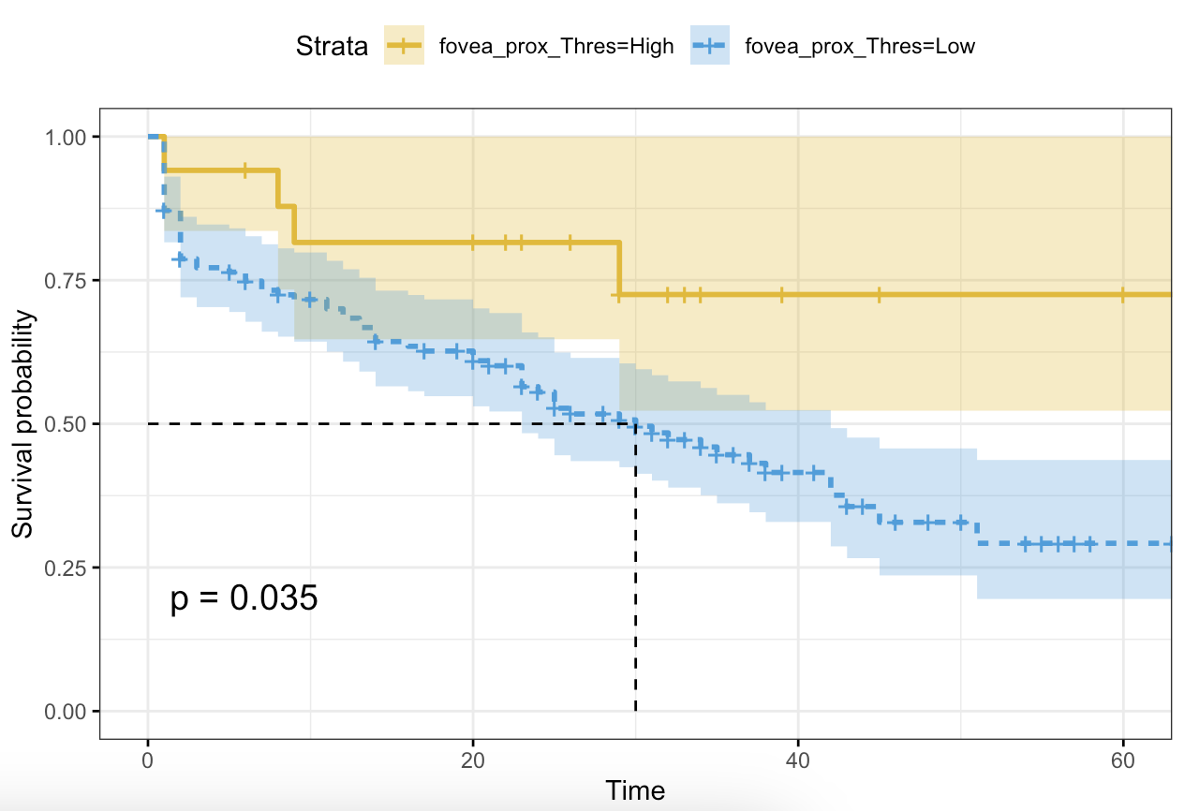
Fovea Proximity
8.5 (percentile 88.6667)

Slide 21
Event: BCVA 20/200 or worse
Time: months from treatment date to BCVA measurement date

Slide 22
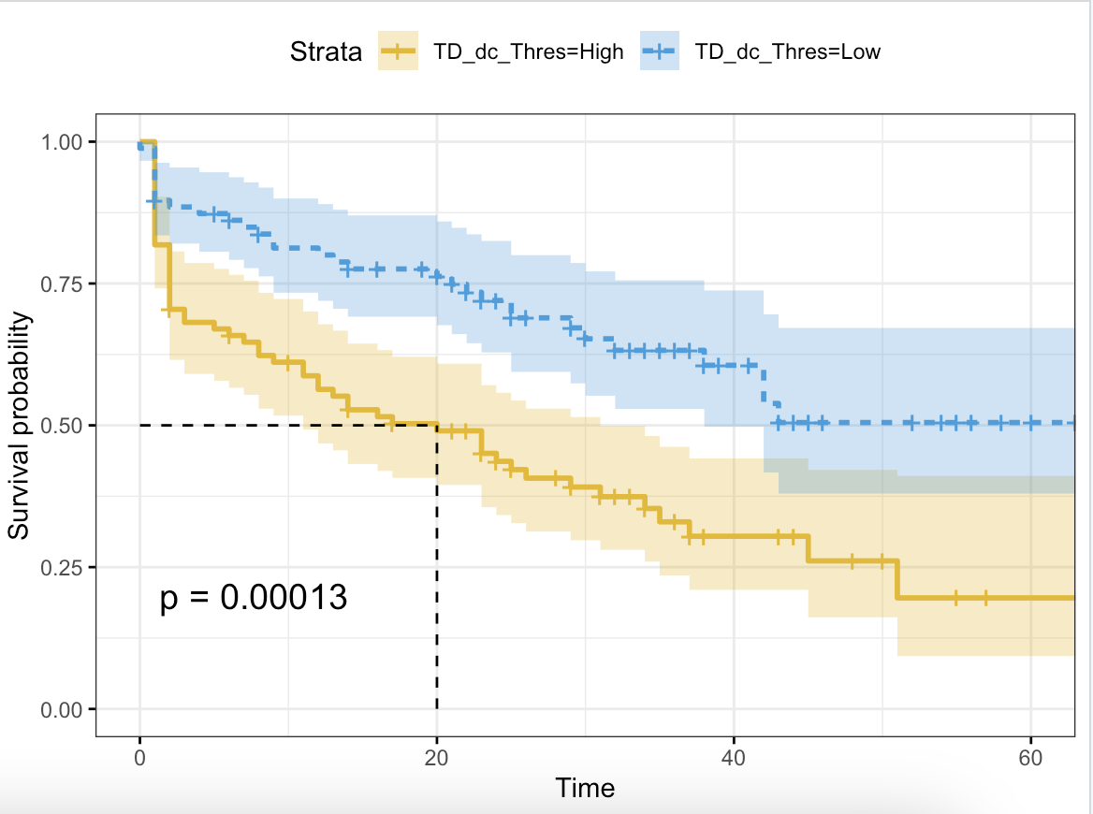
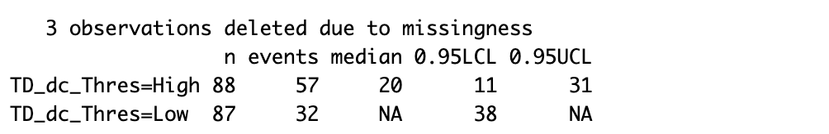
Notes:
median: 33.595 as cutoff
p significant

Slide 23
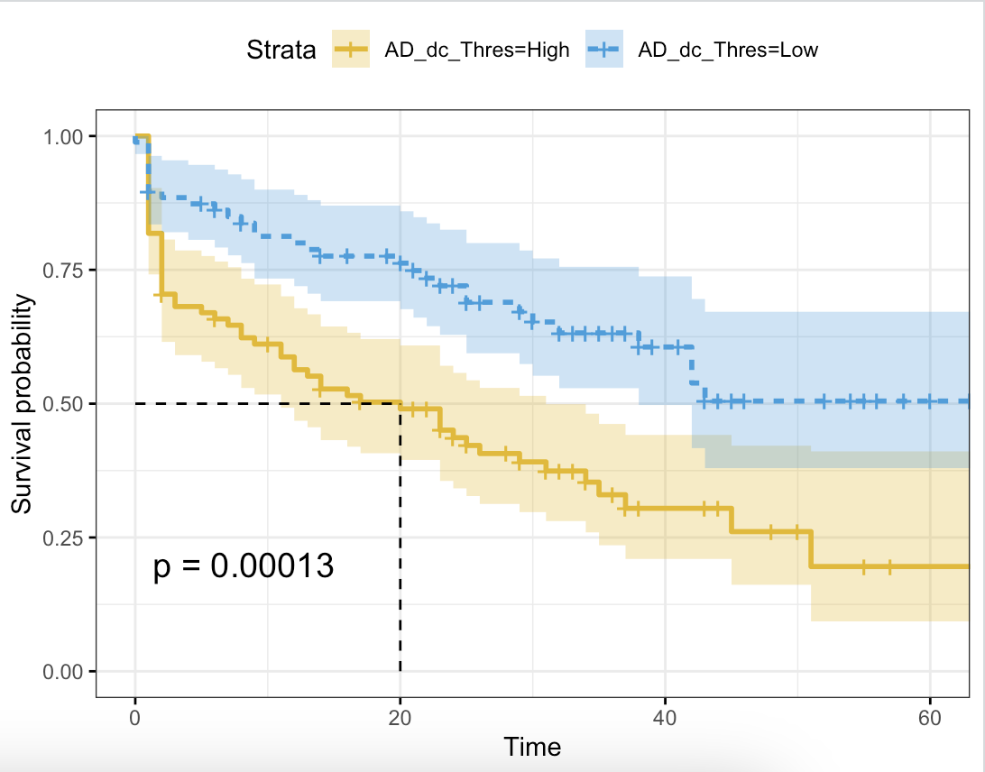
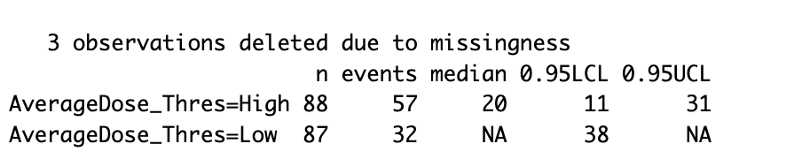
Notes:
Median 46.66 as cutoff
p signiciant

Slide 24
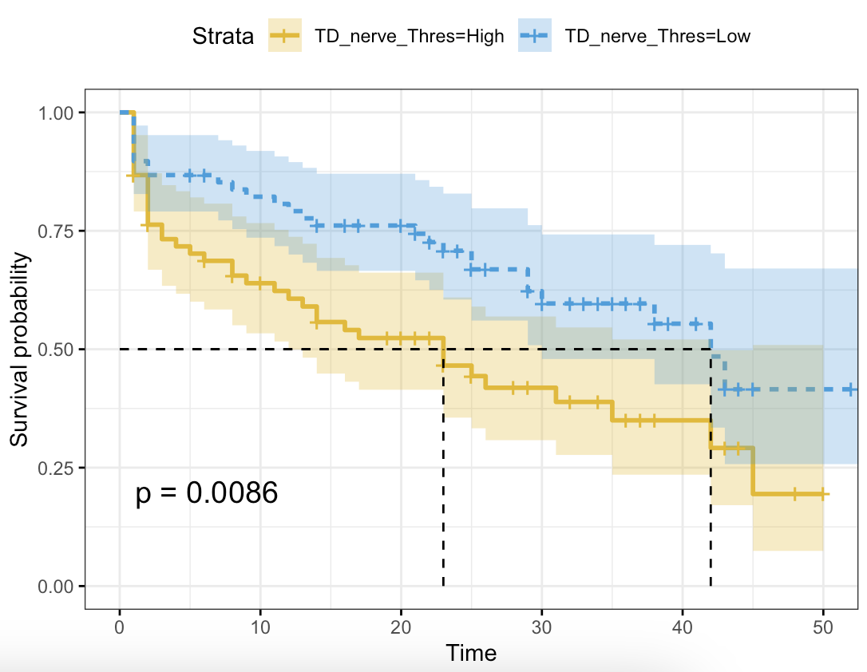
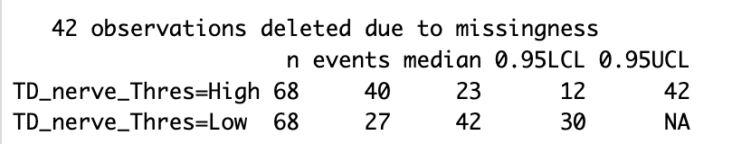
Notes:
Median: 18.575

Slide 25
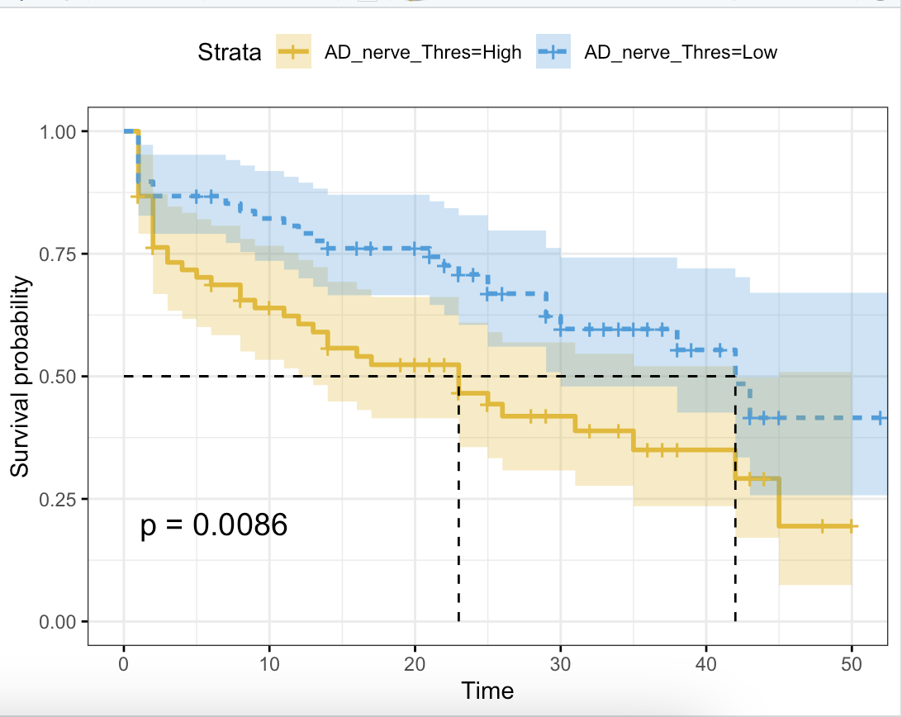
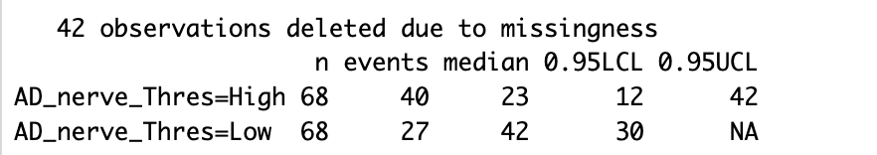
Notes:
Median: 25.8

Slide 26
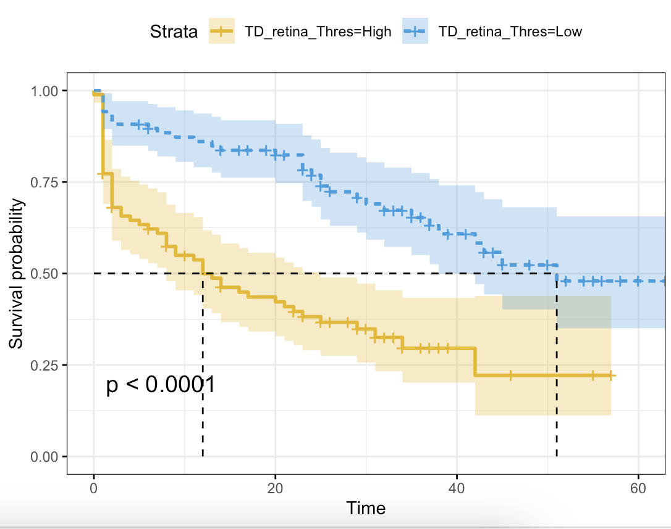
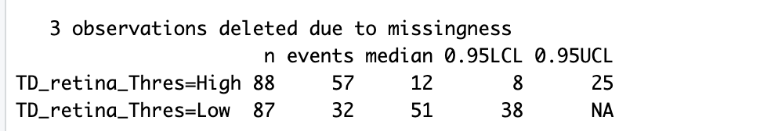
Notes:
Median: 6.5195

Slide 27

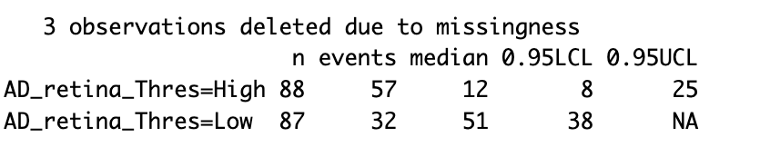
Notes:
Median: 9.055

Slide 28
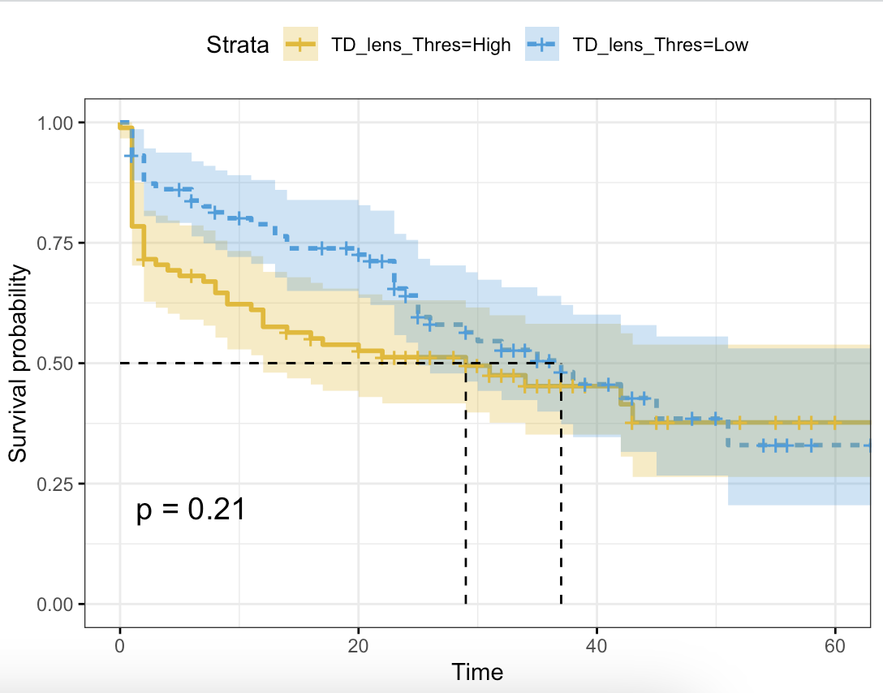
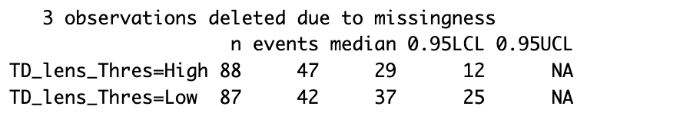
Notes:
Median: 14.25

Slide 29
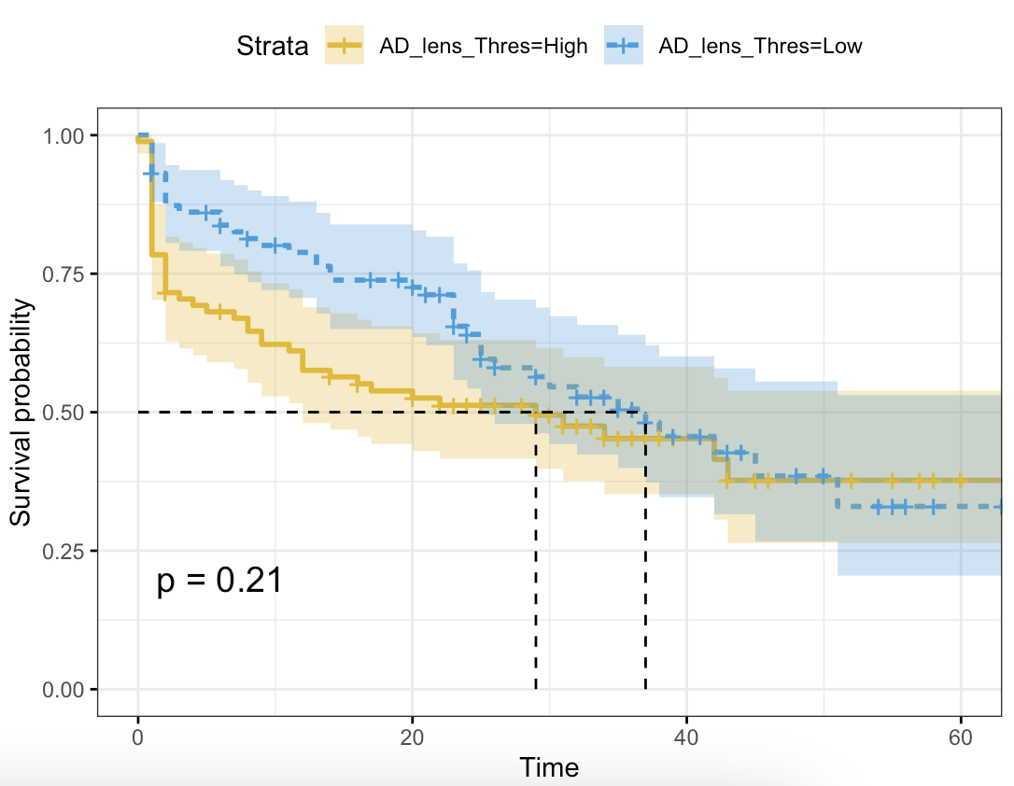
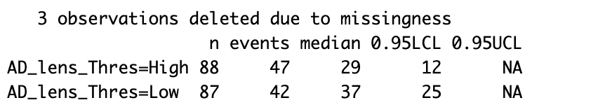
Notes:
Median: 19.79

Slide 30
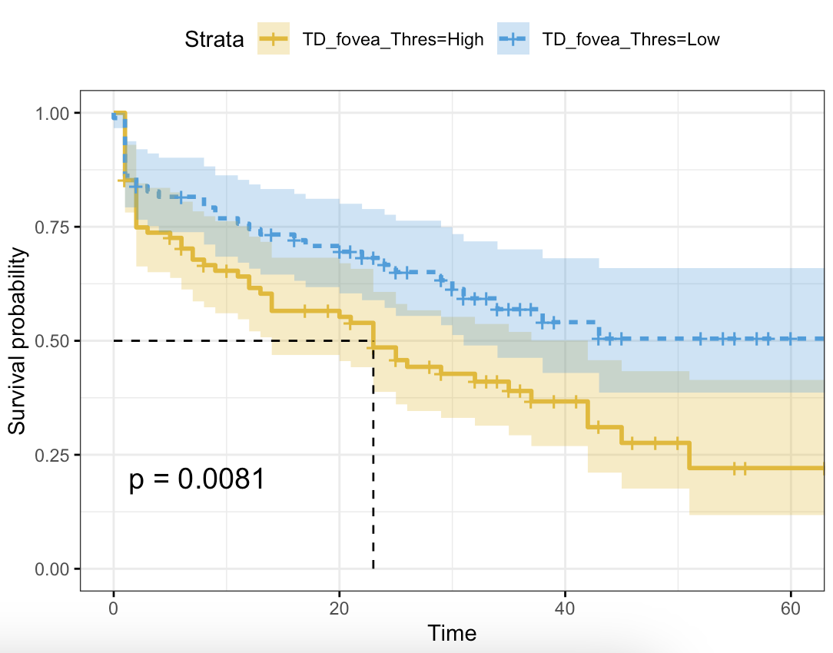
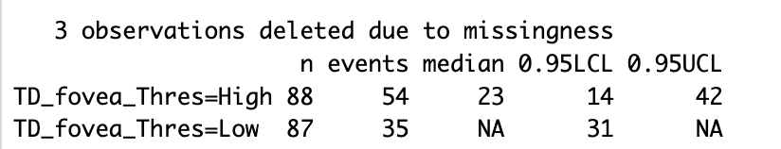
Notes:
Median: 51.095

Slide 31

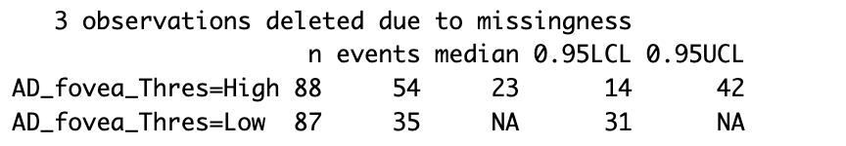
Notes:
Median: 70.965

Slide 32
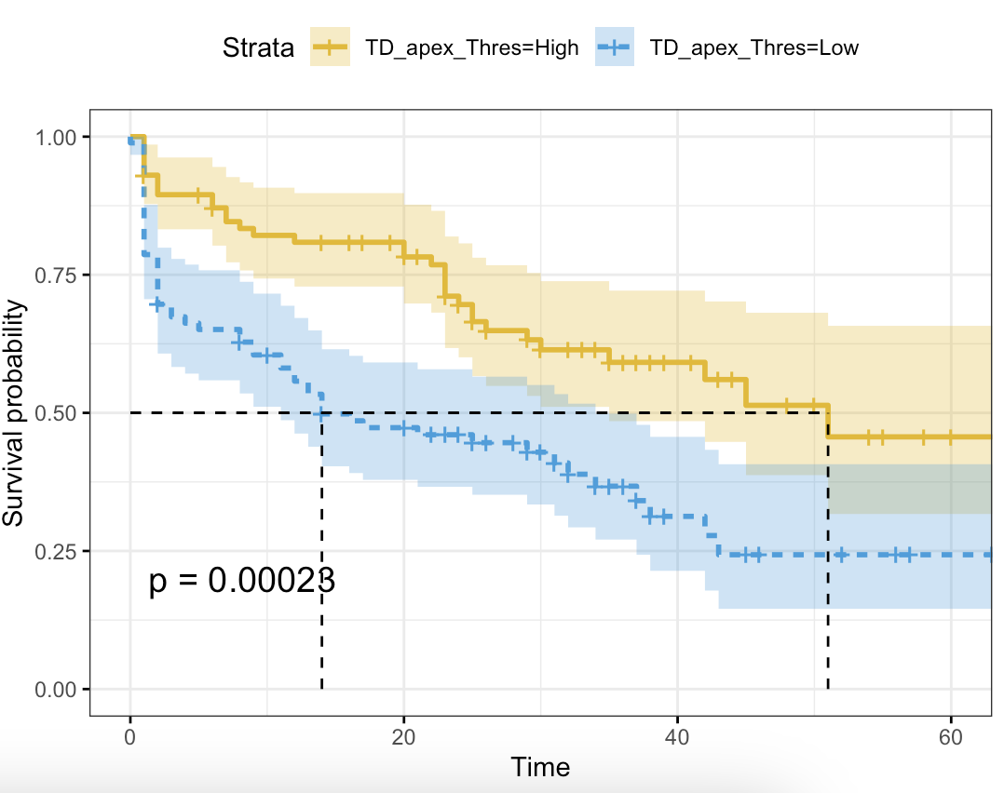

Notes:
Median: 101.2

Slide 33

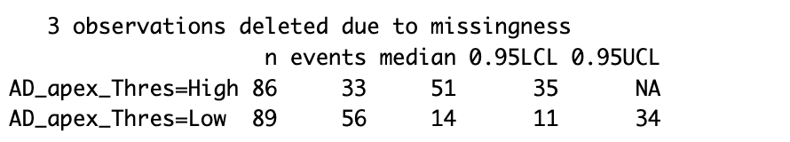
Notes:
Median: 140.5

Slide 34


Notes:
Median: 219.6

Slide 35


Notes:
Median: 305

Slide 36


Optic Nerve Proximity
Notes:
Median 3mm

Slide 37


Fovea Proximity
Notes:
Median: 3mm

Slide 38


Radiation Side Effects

Slide 39


For Tumor Location

Slide 40



Slide 41


For Tumor Location Quadrant

Slide 42


Slide 43

For Baseline 20/40 or better

Slide 44


For Tumor Size

Slide 45

For Tumor Laterality

Slide 46

For Hemorrhage

Slide 47


Diabetes

Slide 48


Hypertension

Slide 49


Cataract (baseline)

Slide 50


Edema

Slide 51


Vasculopathy

Slide 52

Papillitis

Slide 53
Event: loss of 3 (or more) lines of VA
Time: months from treatment date to BCVA measurement date

Slide 54



Slide 55



Slide 56



Slide 57



Slide 58



Slide 59



Slide 60



Slide 61



Slide 62



Slide 63



Slide 64



Slide 65



Slide 66



Slide 67



Slide 68


Optic Nerve Proximity

Slide 69


Fovea Proximity

Slide 70


Radiation Side Effects

Slide 71


Baseline VA 20/40 or better

Slide 72


Tumor Size

Slide 73


Tumor Laterality

Slide 74



Slide 75



Slide 76



Slide 77



Slide 78



Slide 79



Slide 80


Papillitis

Slide 81



Slide 82


Slide 83
Event: loss of 5 (or more) lines of VA
Time: months from treatment date to BCVA measurement date

Slide 84



Slide 85



Slide 86



Slide 87



Slide 88



Slide 89



Slide 90



Slide 91



Slide 92



Slide 93



Slide 94



Slide 95



Slide 96



Slide 97



Slide 98



Slide 99



Slide 100



Slide 101



Slide 102



Slide 103



Slide 104



Slide 105



Slide 106



Slide 107



Slide 108



Slide 109



Slide 110



Slide 111



Slide 112


